Slide 1

Financial
Dashboard
Martin Aldas

Slide 2
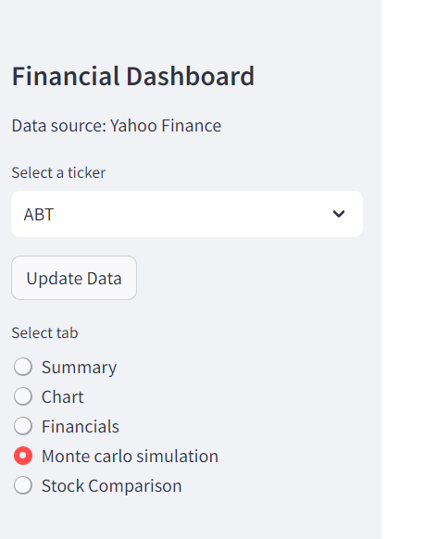
Tap 0
Side Bar
There are 3 selections in the side bar of this dashboard:
Selection of the stock ticker that will be used in 4 of the 5 taps.
Selection of the preferred tab
A button to update the data in the dashboard

Slide 3
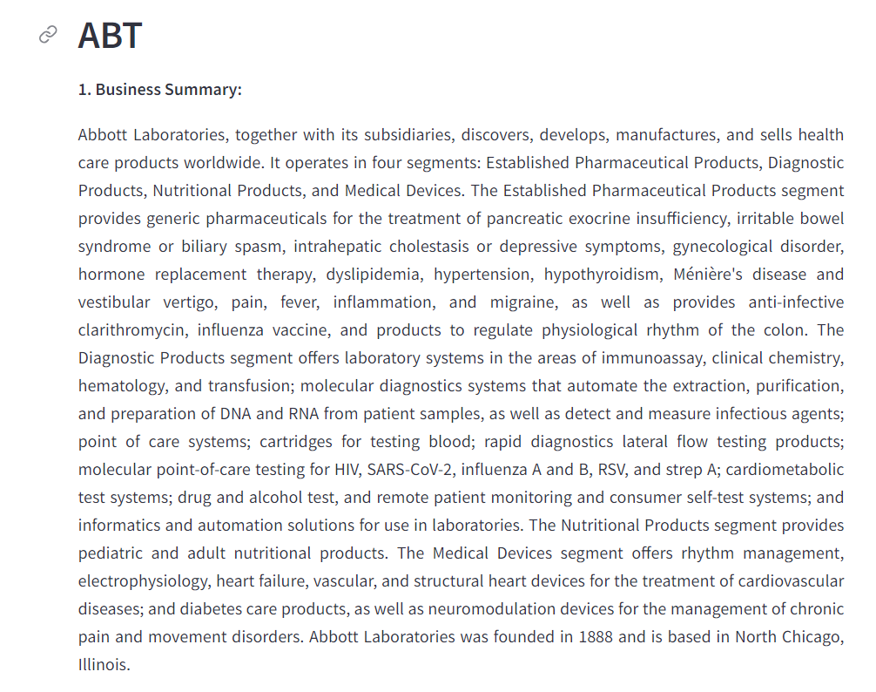
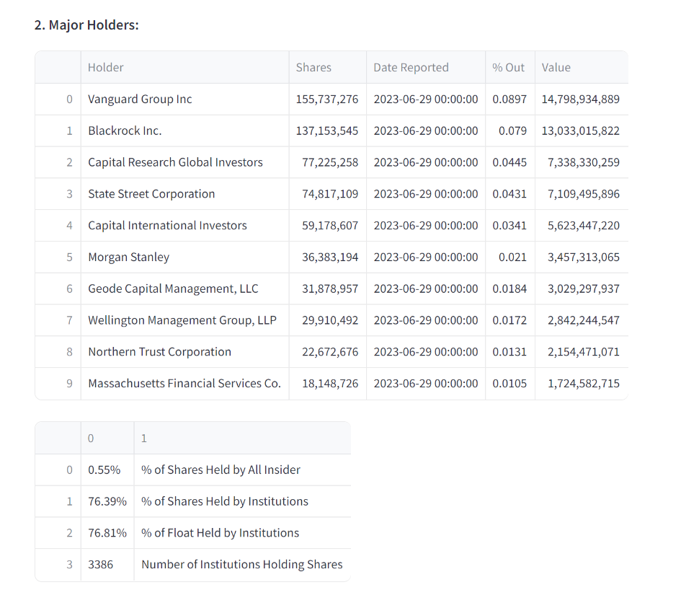
Tab 1
Summary
This tab presents a general overview of a stock.
There is the summary brought from wikipedia.
The Mayor holders is divided into 2 groups.
The upper table bring the mayor enterprises or holders that own the stock.
The lower table brings the % of of the holders

Slide 4
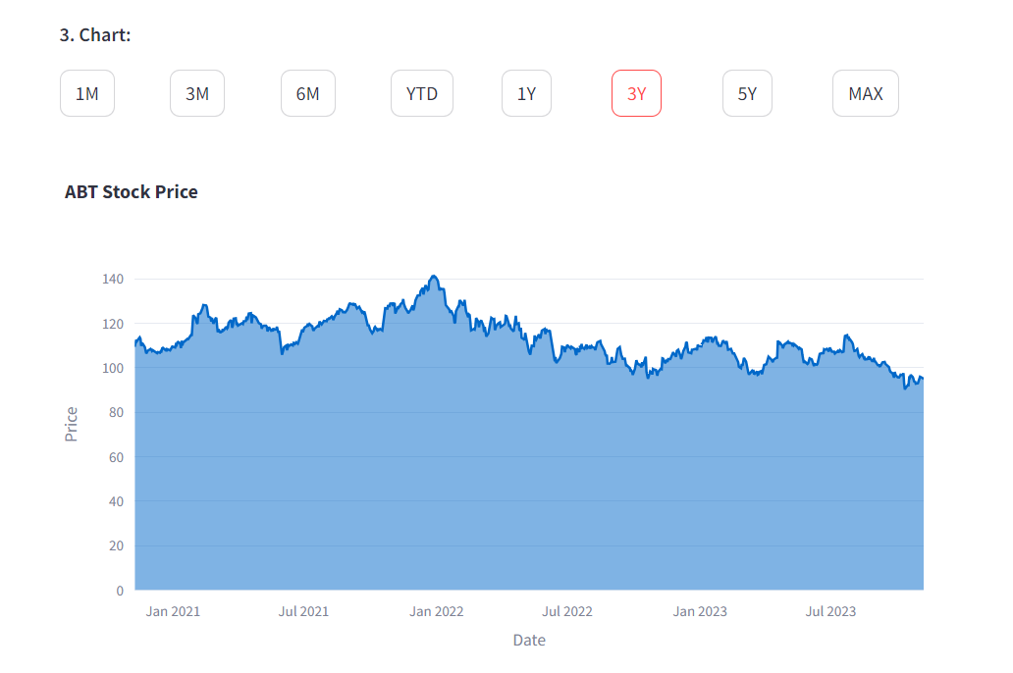
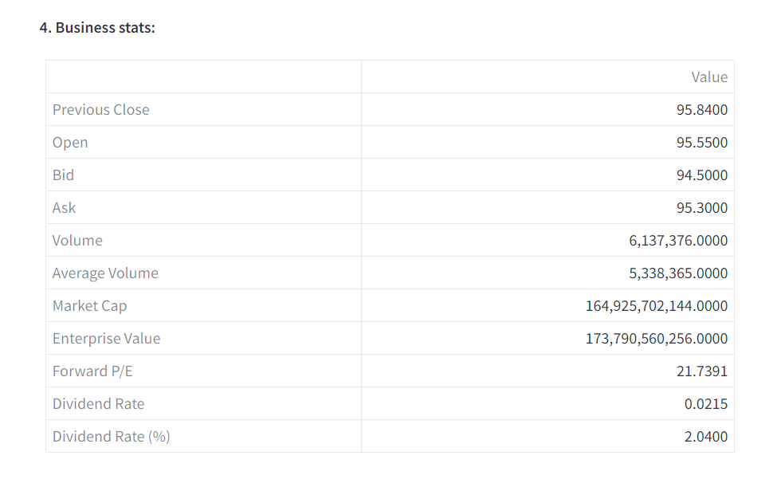
Tab 1
Summary
General line graph of the stock closing prices for the last year; but it can be change if you want to see it in other intervals of time.
Table that bring some of the most important stats of the company stock.

Slide 5
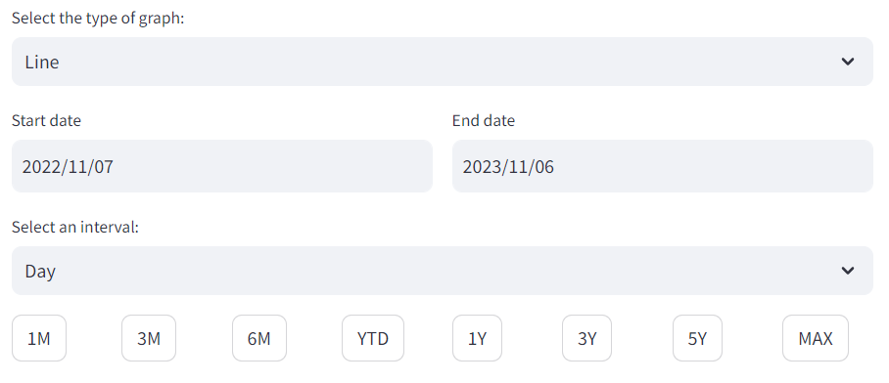
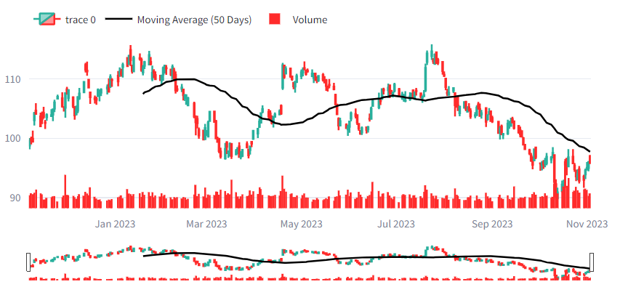
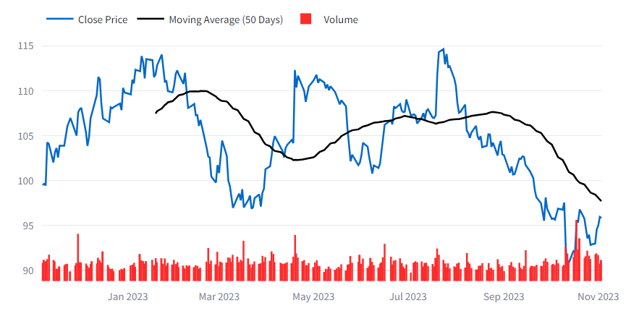
Tab 2
Chart
The chart tap has a base chart of a line graph with a year data with a interval per day. With the option of changing the type of graph:

Slide 6
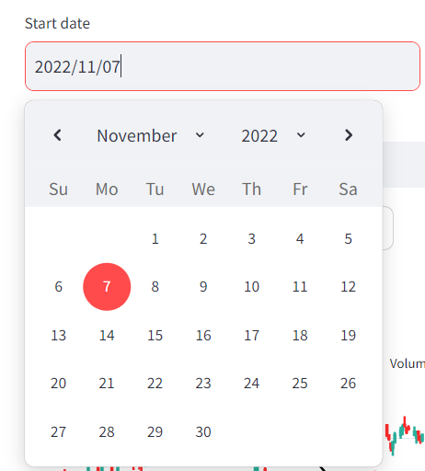
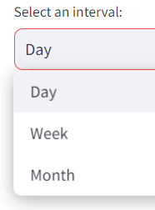
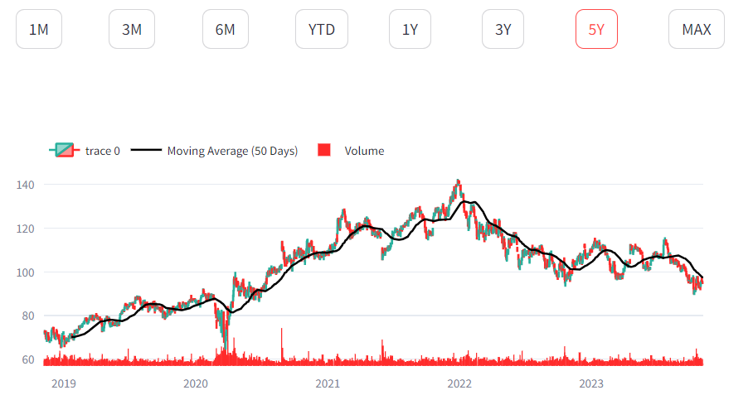
Tab 2
Chart
Option of changing between any date you want the graph to visualize
Option of changing the interval between day, week and month
Option to choose any of the 7 bottoms that will allow you to see a specific timeframe

Slide 7
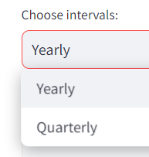
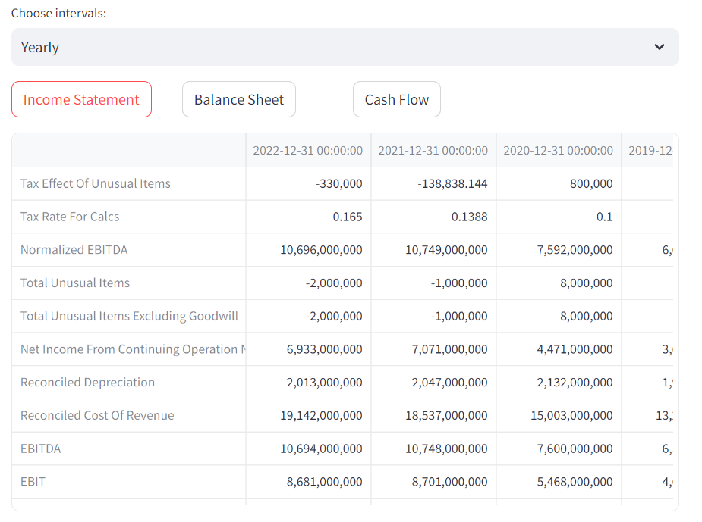
Tab 3
Financial
This taps allow you to selected between 3 different tables that shows the income statement, balance sheet or the cash flow of the selected company.
You can choose if you want to see the reports yearly or quarterly.

Slide 8
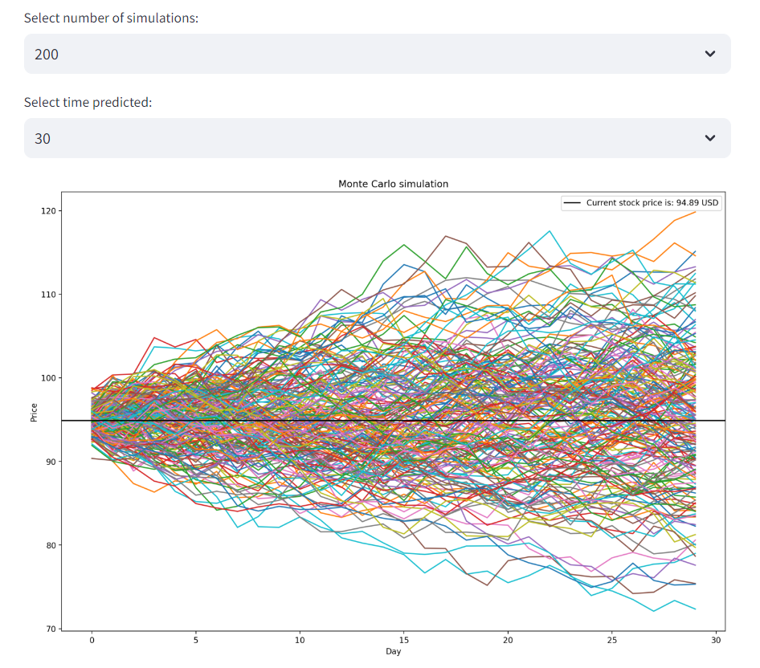
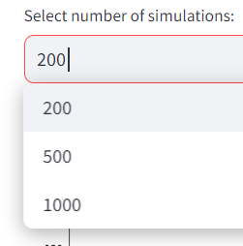
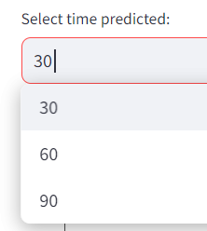
Tab 4
Monte Carlos
This tab will allow you to see a number of monte carlos simulations with the possibility of changing:

Slide 9
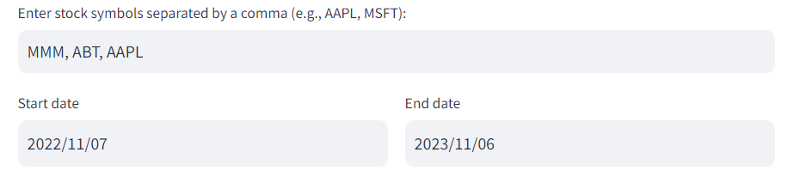
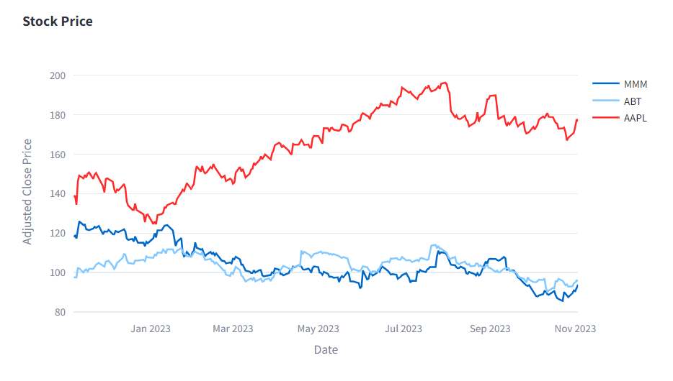
Tab 5
Stock Comparison
This tap allows you to choose to do a comparison between the number of stocks you want.
Line graph of the closing prices of their stocks in the same graph.
Graph for their returns (closing prices with the pct change)
Summary comparing different statistical values of the closing values of each company stock.

Slide 10
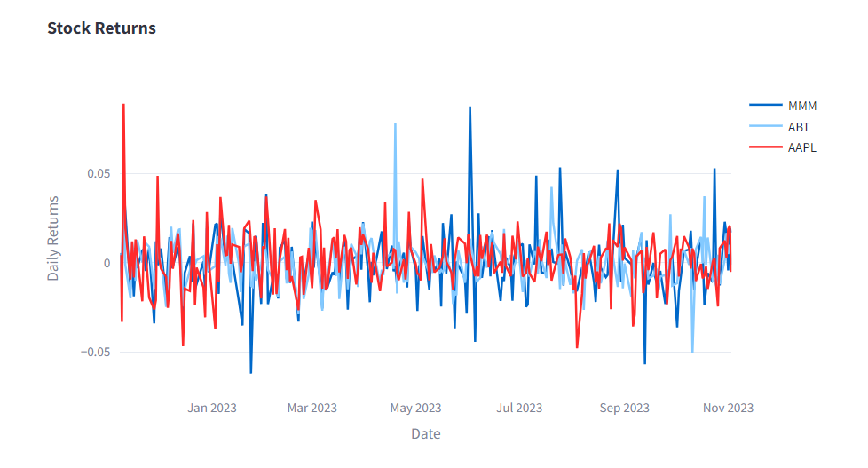
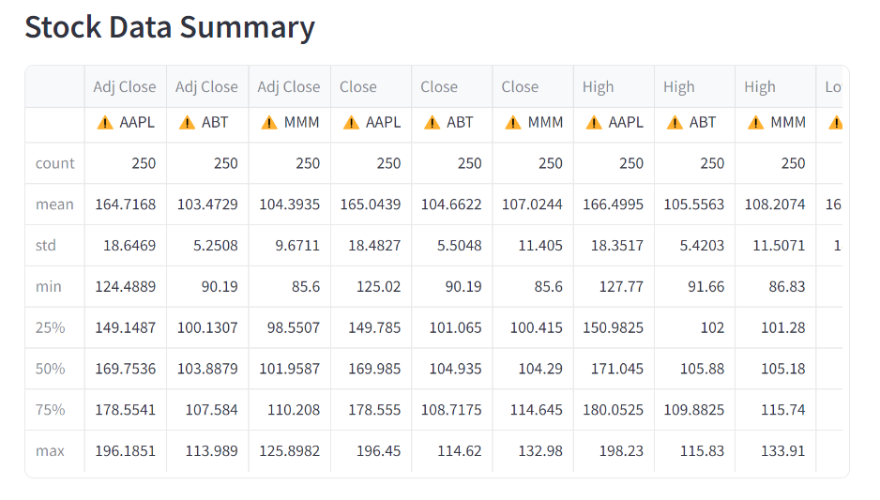
Tab 5
Stock Comparison
This tap allows you to choose to do a comparison between the number of stocks you want.
Line graph of the closing prices of their stocks in the same graph.
Graph for their returns (closing prices with the pct change)
Summary comparing different statistical values of the closing values of each company stock.

Slide 11
Sources
Different jupyter notebooks of the sessions we had
https://finance.yahoo.com/
https://www.youtube.com/watch?v=h83Rc29-GYc
https://docs.streamlit.io/library/api-reference/charts/st.bar_chart
https://www.youtube.com/watch?v=qWXs5_cXxfY
https://medium.com/geekculture/financial-market-dashboards-are-awesome-and-easy-to-create-c0c3ccef9c43
https://algotrading101.com/learn/yfinance-guide/
https://www.qmr.ai/yfinance-library-the-definitive-guide/?utm_content=cmp-true
https://plotly.com/python/subplots/
https://rfachrizal.medium.com/how-to-obtain-financial-statements-from-stocks-using-yfinance-87c432b803b8
https://snyk.io/advisor/python/yfinance/functions/yfinance.Ticker
https://plotly.com/python/legend/
https://chat.openai.com/

